Slide 1

Foundation PHYSICS
Seminar 1: DESCRIBING MOTION AND KINEMATICS

Slide 2
Learning outcomes
Students should be able:
To understand the types of motion.
To distinguish the difference between speed and velocity.
To describe the acceleration and vector components of a given system.

Slide 3
Practice Questions
Which of the following is a vector: a person’s height, the boiling point of water, the cost of a book, the acceleration of gravity?
Is it possible for velocity to be constant while acceleration is not zero? Explain.

Slide 4
ANSWER: Practice Question 1
Explanation:
A vector is a quantity that has both magnitude and direction.
A scalar is a quantity that has only magnitude and no direction.
Here’s the classification of each option:
A person’s height: Scalar (It has magnitude but no direction).
The boiling point of water: Scalar (It is a temperature, which has magnitude but no direction).
The cost of a book: Scalar (It is a price, which has magnitude but no direction).
The acceleration of gravity: Vector (It has both magnitude, typically 9.8 m/s², and direction, which is downward toward the center of the Earth).

Slide 5
ANSWER: Practice Question 2
Explanation:
If the velocity is constant, the acceleration is zero.
However, it is possible for speed to be constant while acceleration is not zero. This situation occurs when an object is undergoing uniform circular motion.
Example: Uniform Circular Motion
Imagine a car driving at a constant speed around a circular track. Although the car's speed remains constant, its direction is continuously changing.
This change in direction means that the car's velocity vector is changing, even though its speed is not..
This implies that the car is accelerating even though its speed is constant.

Slide 6
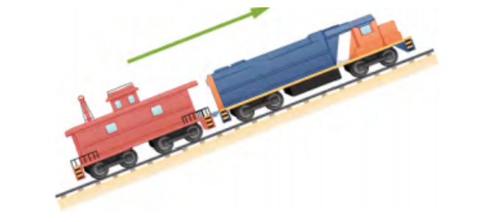
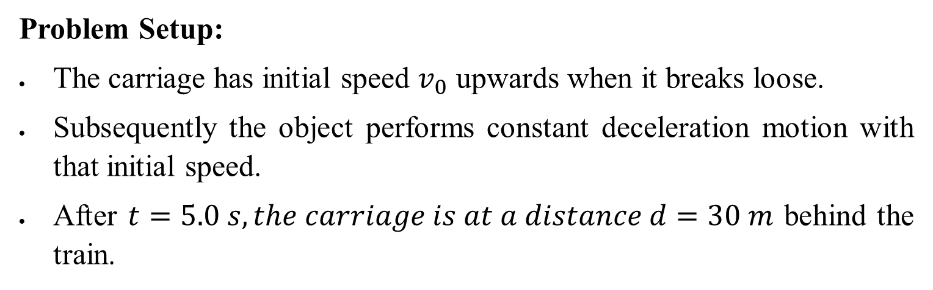
Question 1
A train is moving up a steep slope at constant velocity (see Figure below) when its carriage detached and starts rolling freely along the track. After 5.0 s, the carriage is 30 m behind the train. What is the acceleration of the carriage?
Problem Setup:
The carriage has initial speed $v_{0}$ upwards when it breaks loose.
Subsequently the object performs constant deceleration motion with that initial speed.
After $t=5.0 s, the carriage is at a distance d=30 m$ behind the train.

Slide 7
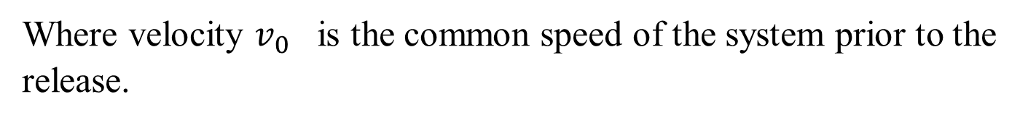

Question 1: ANSWERS
After the release, the train engine continues at constant speed while the carriage performs a constant deceleration motion with the initial speed of the train engine from which it was released.
Position Equation for the Carriage:
The position of the carriage from its initial position after time t can be described by the equation:
S$\left(t\right)=v_{0}t−\frac{1}{2}at^{2}$
Where velocity $v_{0}$ is the common speed of the system prior to the release.

Slide 8

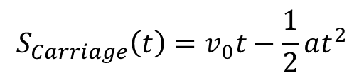
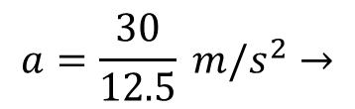
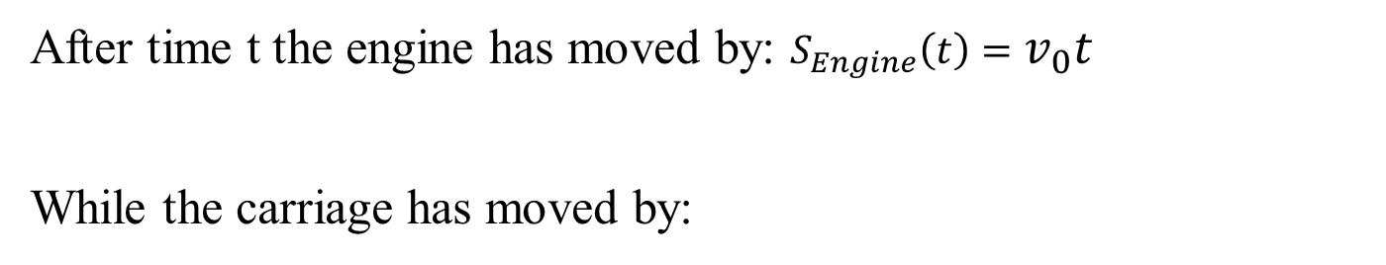

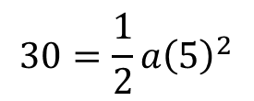
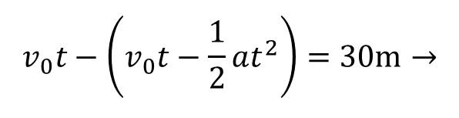
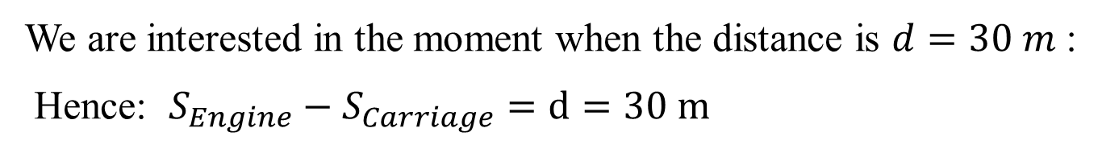
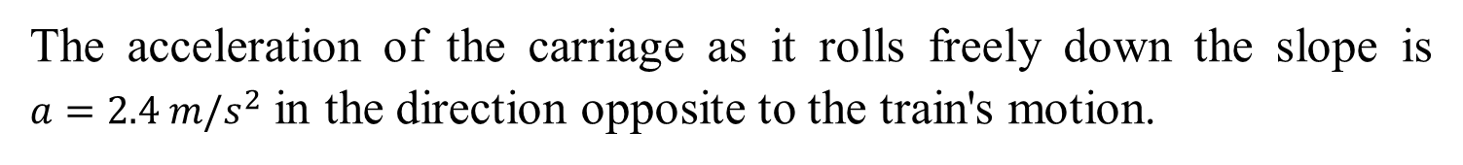
Question 1: ANSWERS
After time t the engine has moved by: $S_{Engine}\left(t\right)=$ $v_{0}t$
While the carriage has moved by:
$$S_{Carriage}\left(t\right)=v_{0}t−\frac{1}{2}at^{2}$$
We are interested in the moment when the distance is $d=30 m$ :
Hence: $S_{Engine}−S_{Carriage}=d=30 m$
Substitute the above equations :
$$v_{0}t−\left(v_{0}t−\frac{1}{2}at^{2}\right)=30m→$$
$$30=\frac{1}{2}a{\left(5\right)}^{2}$$
$$a=\frac{30}{12.5} m/s^{2}→$$
$$a=2.4 m/s^{2}$$
$$30=12.5 a→$$
The acceleration of the carriage as it rolls freely down the slope is $a=2.4 m/s^{2}$ in the direction opposite to the train's motion.

Slide 9
Question 2
An ambulance driver is rushing a patient to hospital. While traveling at 72 km/h, she notices the traffic light at the upcoming intersection has turned amber. To reach the intersection before the light turns red, she must travel 50 m in 2.0 s.
What minimum acceleration must the ambulance have to reach the intersection before the light turns red?
(b) What is the speed of the ambulance when it reaches the
intersection?

Slide 10
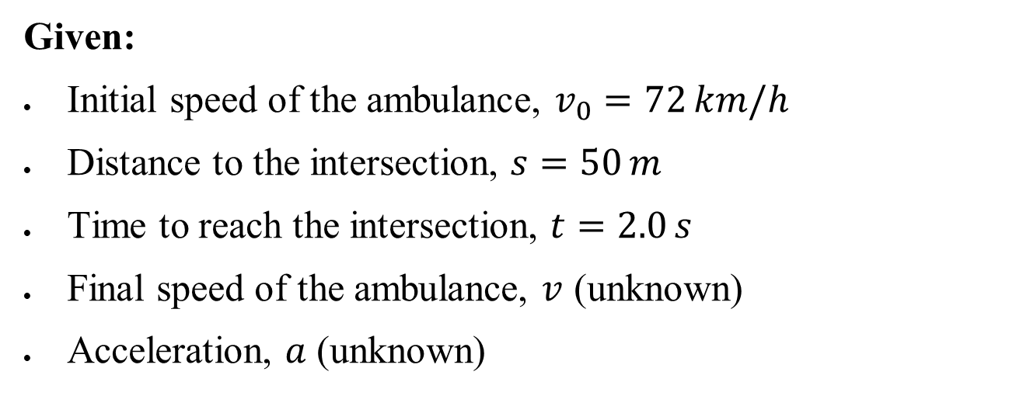
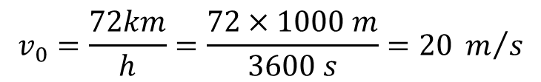
Question 2: ANSWERS
Given:
Initial speed of the ambulance, $v_{0}=72 km/h$
Distance to the intersection, $s=50 m$
Time to reach the intersection, $t=2.0 s$
Final speed of the ambulance, $v$ (unknown)
Acceleration, $a$ (unknown)
Convert the initial speed from $km/h$to $m/s$
$$v_{0}=\frac{72km}{h}=\frac{72×1000 m}{3600 s}=20 m/s$$

Slide 11
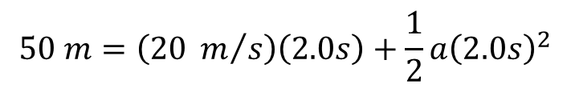
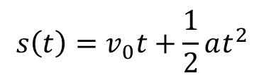


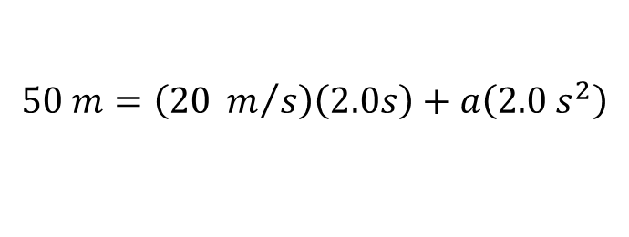
Question 2: ANSWERS
(a) The minimum acceleration must the ambulance have to reach
Use the kinematic equation to find the minimum acceleration
kinematic equation that relates distance, initial speed, time, and acceleration:
$$s\left(t\right)=v_{0}t+\frac{1}{2}at^{2}$$
$$50 m=\left(20 m/s\right)\left(2.0s\right)+\frac{1}{2}a{\left(2.0s\right)}^{2}$$
$$50 m=\left(20 m/s\right)\left(2.0s\right)+a\left(2.0{ s}^{2}\right)$$
$$10 m=a\left(2.0{ s}^{2}\right)$$
$$a=5 m/s^{2}$$
So, the minimum acceleration required is $5 m/s^{2}$

Slide 12



Question 2: ANSWERS
(b) Speed of the Ambulance When It Reaches the Intersection
We can use another kinematic equation to find the final speed:
$$v=v_{0}+at$$
Substituting the known values:
$$v=20+5\left(2.0\right)$$
$$v=30 m/s$$
Speed at the intersection: 30 m/s

Slide 13
Question 3
A cyclist sprints at the end of a race to clinch a victory. She has an initial velocity of 11.5 m/s and accelerates at a rate of 0.5 m/s² for 7 s.
What is her final velocity?
The cyclist continues at this velocity to the finish line. If she is 300 m from the finish line when she starts to accelerate, how much time did she save?
The second-place winner was 5.0 m ahead when the winner started to accelerate, but he was unable to accelerate, and traveled at 11.8 m/s until the finish line. What was the difference in finish time in seconds between the winner and runner-up? How far back was the runner-up when the winner crossed the finish line?

Slide 14
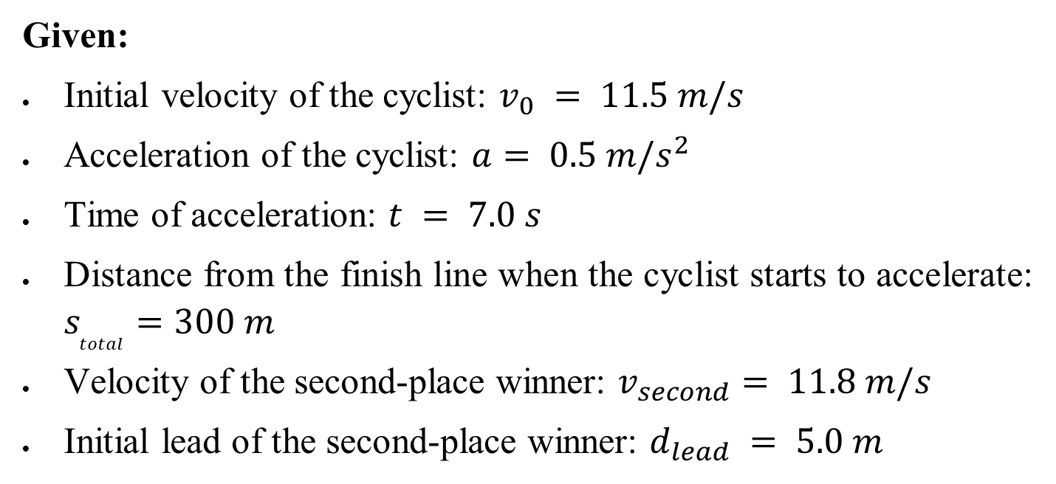
Question 3: ANSWERS
Given:
Initial velocity of the cyclist: $v_{0} = 11.5 m/s$
Acceleration of the cyclist: $a= 0.5 m/s^{2}$
Time of acceleration: $t = 7.0 s$
Distance from the finish line when the cyclist starts to accelerate: $​s_{total}=300 m$
Velocity of the second-place winner: $v_{second}= 11.8 m/s$
Initial lead of the second-place winner: $​d_{lead} = 5.0 m$

Slide 15

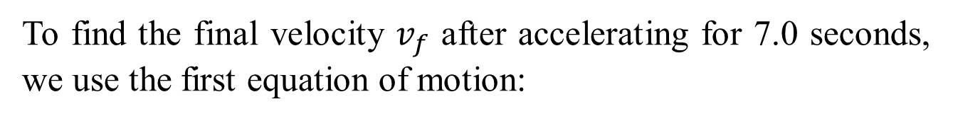
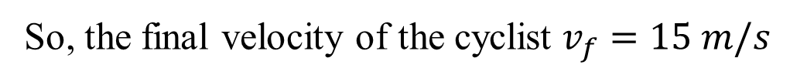
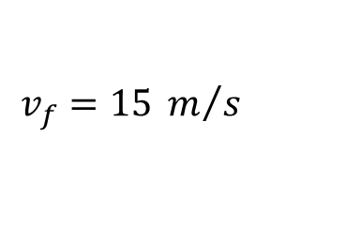
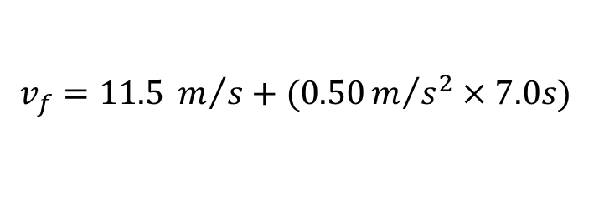
Question 3: ANSWERS
(a) Final Velocity of the Cyclist
To find the final velocity $v_{f}$ after accelerating for 7.0 seconds, we use the first equation of motion:
$$v=v_{0}+at$$
$$v_{f}=11.5 m/s+(0.50m/{s^{2}}×7.0s)$$
$$v_{f}=15 m/s$$
So, the final velocity of the cyclist $v_{f}=15 m/s$

Slide 16
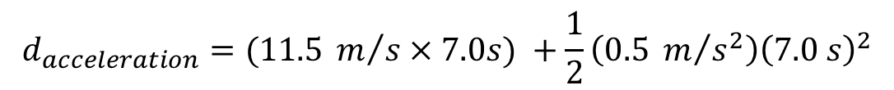
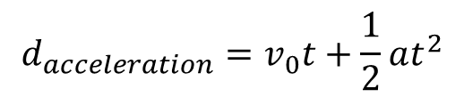
Question 3: ANSWERS
(b) Time Saved by the Cyclist
First, let's calculate the distance covered during the acceleration phase using the kinematic equation:
$$d_{acceleration}=v_{0}t+\frac{1}{2}at^{2}$$
$$d_{acceleration}=(11.5 m/s×7.0s) +\frac{1}{2}\left(0.5 m/{s^{2}}\right){\left(7.0 s\right)}^{2}$$
$$d_{acceleration}=80.5 m+12.25 m=92.75 m$$
The remaining distance to the finish line after acceleration is:
$$d_{remaining}=300 m−92.75 m=207.25 m$$

Slide 17
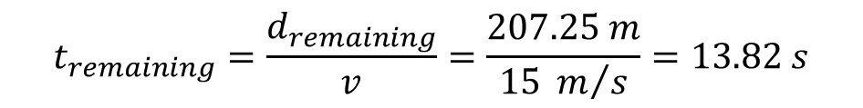
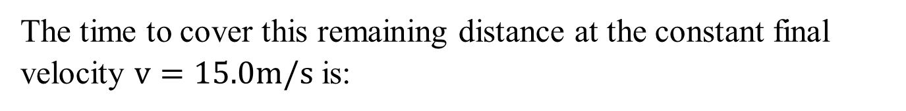
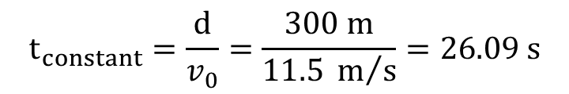
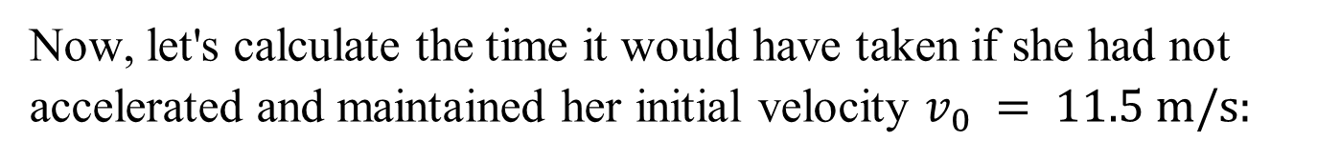
Question 3: ANSWERS
(b) Time Saved by the Cyclist
The time to cover this remaining distance at the constant final velocity $v=15.0m/s$ is:
$$t_{remaining}=\frac{d_{remaining}}{v}=\frac{207.25 m}{15 m/s}=13.82 s$$
The total time taken by the cyclist to finish the race is:
$$t_{total}=t_{acceleration}+t_{remaining}=7.0s+13.82 s=20.82 s$$
Now, let's calculate the time it would have taken if she had not accelerated and maintained her initial velocity $v_{0} = 11.5 m/s:$
$$t_{constant}=\frac{d}{v_{0}}=\frac{300 m}{11.5 m/s}=26.09 s$$
The time saved by accelerating is:
$$t_{saved}=t_{constant}−t_{total}=26.09 s−20.82 s=5.27 s$$

Slide 18
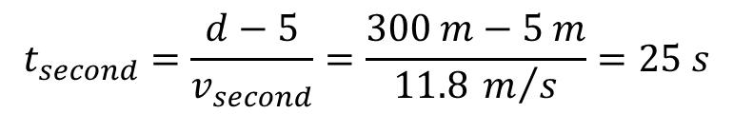
Question 3: ANSWERS
(c) Difference in Finish Time and Distance Behind
First, let's calculate the time it takes for the second-place winner to reach the finish line:
$$t_{second}=\frac{d−5}{v_{second}}=\frac{300 m−5 m}{11.8 m/s}=25 s$$
The difference in finish time between the winner and runner-up is:
$$Time difference=t_{second}−t_{total}$$
$$Time difference=25.00 s−20.82 s=4.18 s$$
To find how far back the runner-up was when the winner crossed the finish line, we use the time difference and the runner-up's speed:
$$Distance behind=v_{second}×Time difference$$
$$Distance behind=11.8 m/s×4.18s=49.32 s$$

Slide 19
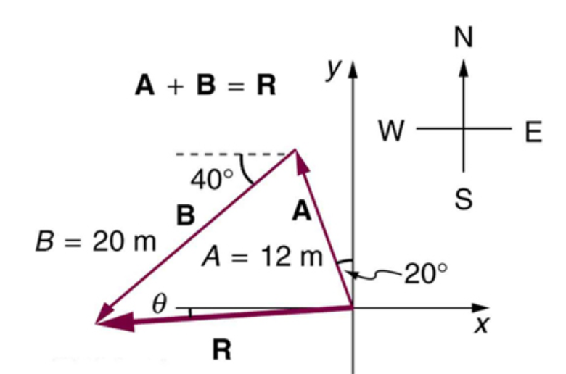
Question 4
Suppose you first walk 12 m in a direction 20º west of north and then 20 m in a direction 40º south of west. How far are you from your starting point, and what is the compass direction of a line connecting your starting point to your final position? (If you represent the two legs of the walk as vector displacements A and B, as in Figure below, then find their sum R = A + B).

Slide 20
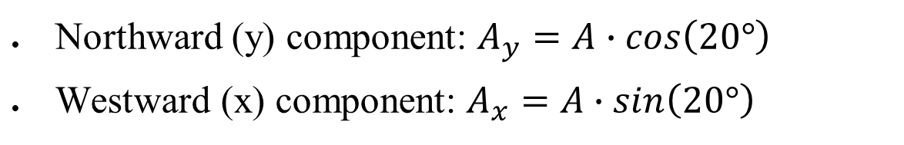

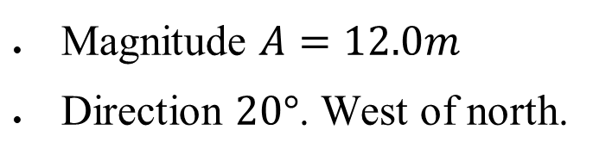
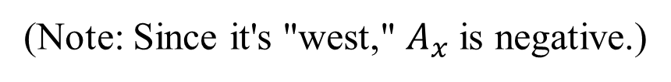


Question 4: ANSWERS
Step 1: Break Down the Vectors into Components
Vector A:
Magnitude $A=12.0m$
Direction $20°$. West of north.
To break down vector A into its components:
Northward (y) component: $A_{y}=A∙cos\left(20°\right)$
Westward (x) component: $A_{x}=A∙sin\left(20°\right)$
Substituting the values:
$$A_{y}=12 m∙cos\left(20°\right)=11.28 m$$
$$A_{x}=12 m∙sin\left(20°\right)=4.10 m$$
(Note: Since it's "west," $A_{x}$ is negative.)
$$A_{y}=11.28 m, A_{x}=−4.10 m$$

Slide 21
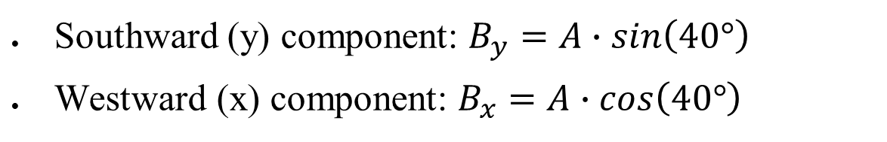

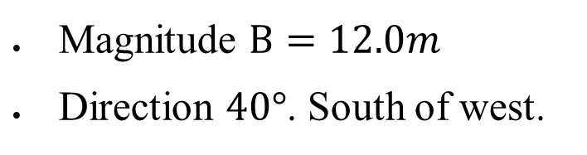
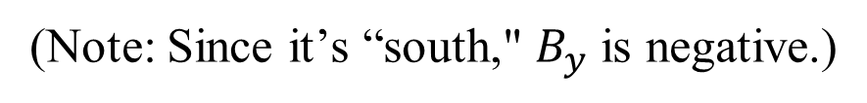


Question 4: ANSWERS
Step 1: Break Down the Vectors into Components
Vector B:
Magnitude $B=12.0m$
Direction $40°$. South of west.
To break down vector A into its components:
Southward (y) component: $B_{y}=A∙sin\left(40°\right)$
Westward (x) component: $B_{x}=A∙cos\left(40°\right)$
Substituting the values:
$$B_{y}=20 m∙sin\left(40°\right)=12.86 m$$
$$B_{x}=20 m∙cos\left(40°\right)=15.32 m$$
(Note: Since it’s “south," $B_{y}$ is negative.)
$$B_{x}=−15.32 m, B_{y}=−12.86 m$$

Slide 22


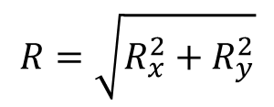
Question 4: ANSWERS
Step 2: Sum the Components to Find the Resultant Vector R
The x-component and y-component of the resultant vector R are found by summing the corresponding components of A and B:
$$R_{x}=A_{x}+B_{x}=−4.10 m+\left(−15.32 m\right)=−19.42 m$$
$$R_{y}=A_{y}+B_{y}=11.28 m+\left(−12.86 m\right)=−1.58 m$$
Step 3: Find the Magnitude of the Resultant Vector
The magnitude of R is given by:
$$R=\sqrt{R_{x}^{2}+R_{y}^{2}}$$
$$R=\sqrt{{\left(−19.42 m\right)}^{2}+{\left(−1.58 m\right)}^{2}}$$
$$R=19.48 m$$

Slide 23
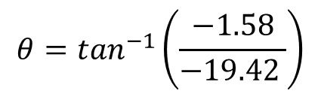
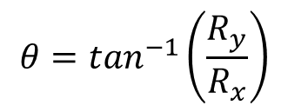
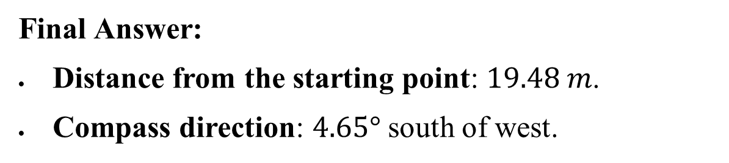

Question 4: ANSWERS
Step 4: Find the Direction of the Resultant Vector
The direction θ of R relative to the westward direction is given by:
$$θ=\tan^{−1}\left(\frac{R_{y}}{R_{x}}\right)$$
$$θ=\tan^{−1}\left(\frac{−1.58}{−19.42 }\right)$$
$$θ=4.65°$$
This angle is south of west because both $R_{x}$​ and $R_{y}$ are negative.
Final Answer:
Distance from the starting point: $19.48 m$.
Compass direction: $4.65°$ south of west.

Slide 24
Question 5
A student drove to university from their home and noted that the odometer reading of their car increased by 12.0 km. The trip took 18.0 min.
What was their average speed?
If the straight-line distance from their home to university is 10.3 km in a direction 25.0º south of east, what was their average velocity?
If they returned home by the same route 7 h 30 min after they left, what were their average speed and velocity for the entire trip?

Slide 25
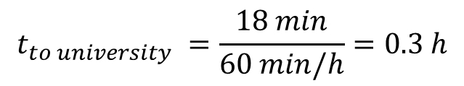
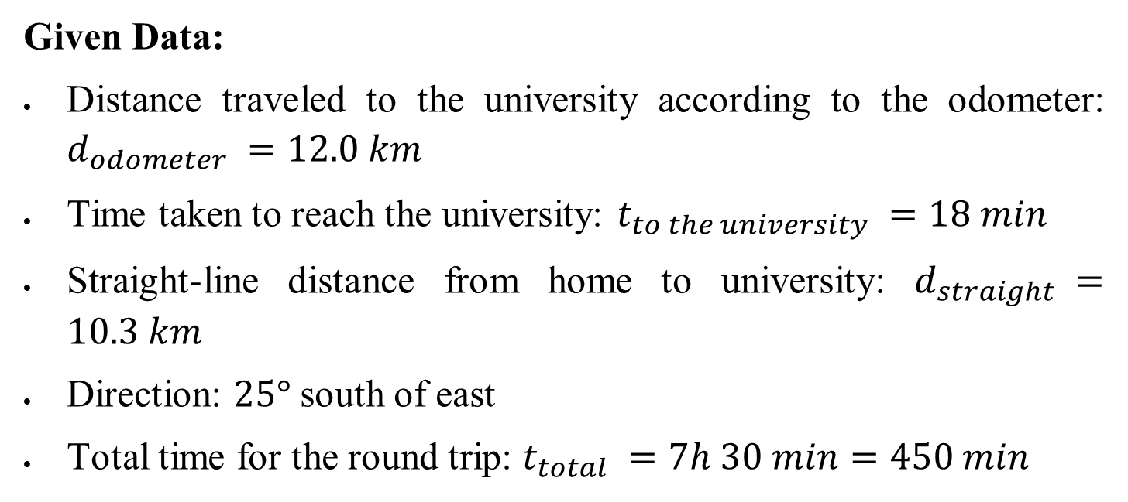
Question 5: ANSWERS
Given Data:
Distance traveled to the university according to the odometer: $d_{odometer} ​=12.0 km$
Time taken to reach the university: $t_{to the university} ​=18 min$
Straight-line distance from home to university: $d_{straight} ​=10.3 km$
Direction: $25°$ south of east
Total time for the round trip: $t_{total} ​=7h 30 min=450 min$
Convert the time from minutes to hours:
$$t_{to university} ​=\frac{18 min}{60 min/h}=0.3 h$$

Slide 26
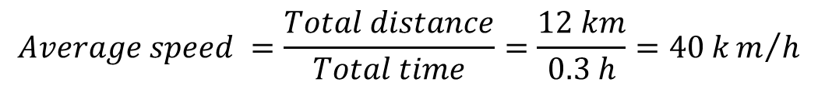

Question 5: ANSWERS
(a) Average Speed
Average speed is defined as the total distance traveled divided by the total time taken.
$$Average speed ​=\frac{Total distance}{Total time}=\frac{12 km}{0.3 h}=40 km/h$$
(b) Average Velocity
Average velocity is a vector quantity and is defined as the displacement divided by the total time taken.
$$Average velocity ​=\frac{Displacement}{Total time}=\frac{10.3 km}{0.3 h}=34.3 km/h$$
Direction:$25° south of east$

Slide 27
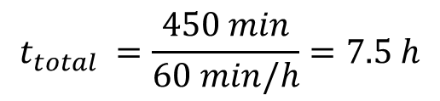
Question 5: ANSWERS
(c) Average Speed for the Entire Trip
Since the student returned home by the same path, the total distance traveled is:
$$Total distance=2×12 km=24 km$$
Convert the total time from minutes to hours:
$$t_{total} ​=\frac{450 min}{60 min/h}=7.5 h$$
Average Speed for the Entire Trip:
$$Average speed ​=\frac{Total distance}{Total time}=\frac{24 km}{7.5 h}=3.2 km/h$$

Slide 28
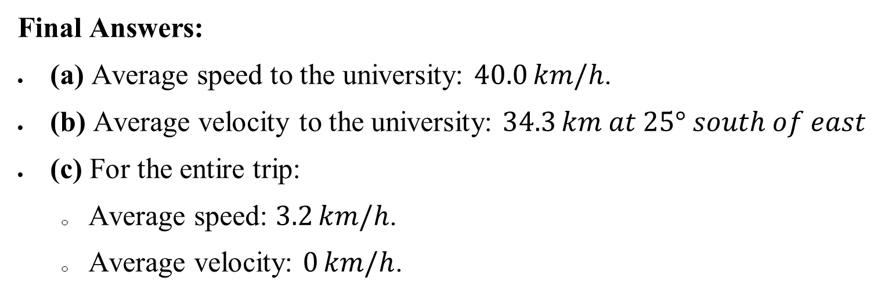
Question 5: ANSWERS
(c) Average Velocity for the Entire Trip
Since the student returned to the starting point, the displacement is zero. Therefore, the average velocity is:
$$Average velocity ​=\frac{Displacement}{Total time}=\frac{0 km}{7.5 h}=0 km/h$$
Final Answers:
(a) Average speed to the university: $40.0 km/h$.
(b) Average velocity to the university: $34.3 km at 25° south of east$
(c) For the entire trip:
Average speed: $3.2 km/h$.
Average velocity: $0 km/h$.

Slide 29
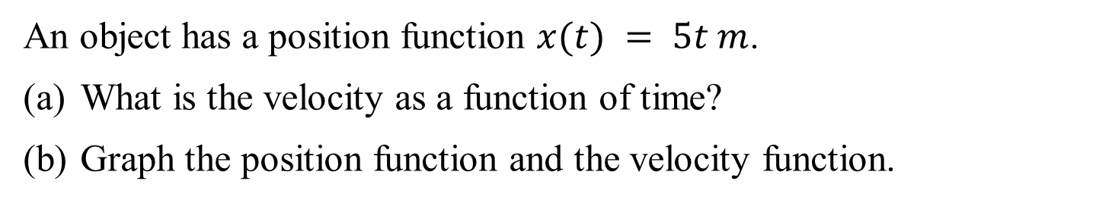
Question 6
An object has a position function $x(t) = 5t m$.
What is the velocity as a function of time?
Graph the position function and the velocity function.

Slide 30

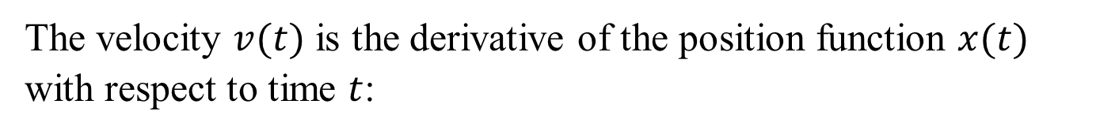
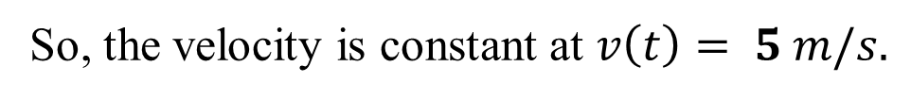
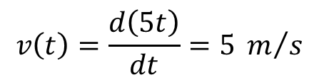
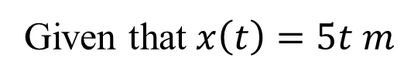
Question 6: ANSWERS
(a) Velocity as a function of time
The velocity $v(t)$ is the derivative of the position function $x(t)$ with respect to time $t$:
$$v\left(t\right)=\frac{dx\left(t\right)}{dt}$$
Given that $x\left(t\right)=5t m$
$$v\left(t\right)=\frac{d\left(5t\right)}{dt}=5 m/s$$
So, the velocity is constant at $v\left(t\right)= 5 m/s.$

Slide 31
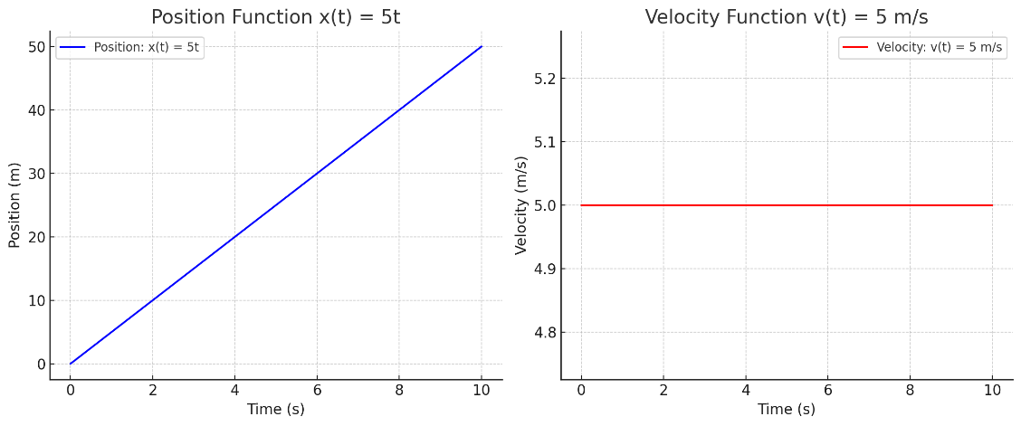



Question 6: ANSWERS
(b) Graphing the Position and Velocity as a function of time
The position function $x(t)=5t$ is a straight line with a slope of 5, passing through the origin.
The velocity function $v(t)=5 m/s$ is a horizontal line since the velocity is constant.

Slide 32

Question 7
A particle moves along the x-axis according to
$x(t) = 10t − 2t^{2} m.$
What is the particle’s instantaneous velocity at $t = 2 s and t = 3 s$?
(b) What is the particle’s instantaneous speed at these times?
(c) What is the particle’s average velocity between $t = 2 s and t = 3 s?$
(d) Graph the position function and the velocity function.

Slide 33








Question 7: ANSWERS
(a) Instantaneous Velocity at $t = 2 s and t = 3 s$
The instantaneous velocity $v(t)$ is the derivative of the position function $x(t)$ with respect to time $t$:
$$v\left(t\right)=\frac{dx\left(t\right)}{dt}$$
Given that $x(t)= 10t−2t^{2}$
$$v\left(t\right)=\frac{d\left(10t−2t^{2} \right)}{dt}=10−4t m/s$$
Now, we can find the instantaneous velocity at the specified times:
At $t = 2 s$
$$v\left(2\right)=10−4\left(2\right)m/s=2 m/s$$
At $t = 3 s$
$$v\left(3\right)=10−4\left(3\right)m/s=−2 m/s$$

Slide 34







Question 7: ANSWERS
(b) Instantaneous Speed at $t = 2 s and t = 3 s$
Instantaneous speed is the magnitude of the instantaneous velocity:
At $t = 2 s$
$$\left|v\left(2\right)\right|=\left|10−4\left(2\right) m/s\right|=2 m/s$$
At $t = 3 s$
$$\left|v\left(3\right)\right|=\left|10−4\left(3\right) m/s\right|=2 m/s$$
(c) Average velocity between $t = 2 s and t = 3 s$
Average velocity $v_{avg}$ is given by:
$$v_{avg}=\frac{x\left(t_{2}\right)−x\left(t_{1}\right)}{t_{2}−t_{1}}$$
Where $t_{1}=2s$ and $t_{2}=3s$.

Slide 35








Question 7: ANSWERS
(c) Average velocity between $t = 2 s and t = 3 s$
Average velocity $v_{avg}$ is given by:
$$v_{avg}=\frac{x\left(t_{2}\right)−x\left(t_{1}\right)}{t_{2}−t_{1}}$$
Where $t_{1}=2s$ and $t_{2}=3s$.
First, calculate the position at these times:
At $t = 2 s$
$$x\left(2\right)=10\left(2\right)−2{\left(2\right)}^{2} m=12 m$$
At $t = 3 s$
$$x\left(3\right)=10\left(3\right)−2{\left(3\right)}^{2} m=12 m$$
Now, the average velocity is:
$$v_{avg}=\frac{x\left(3\right)−x\left(2\right)}{3−2}=\frac{12−12}{1}=0 m$$

Slide 36


Question 7: ANSWERS
(d) Graphing the Position and Velocity as a function of time.
Position Function $x(t)=10t−2t^{2} m$. The position function is the parabola seen below.
Velocity Function $v(t)=10−4t m$. The velocity function is a straight line with a negative slope, indicating a decrease in velocity over time.

Slide 37

Question 8
Freight trains can produce only relatively small accelerations and decelerations.
What is the final velocity of a freight train that accelerates at a rate of $0.05 m/s^{2}$ for $8.0 min$, starting with an initial velocity of $4.0 m/s$?
If the train slows down at a rate of $0.55 m/s^{2}$, how long will it take to come to a stop from this velocity?
How far will it travel in each case?

Slide 38




Question 8: ANSWERS
Given Data:
Initial velocity $v_{0}=4 m/s$
Acceleration during speeding up $a_{1}​=0.05m/s^{2}$
Time of acceleration $t_{1}=8 min=8×60s=480 s$
Deceleration rate $a_{2}​=−0.55 m/s^{2}$ (negative because it’s deceleration)
(a) Final Velocity After Acceleration
$$v_{f}=v_{0}+a_{1}t_{1}$$
Substituting the given values:
$$v_{f}=4 m/s+\left(0.05 m/{s^{2}}\right)\left(480 s\right)$$
$$v_{f}=28 m/s$$
So, the final velocity of the train is 28 m/s.

Slide 39




Question 8: ANSWERS
(b) Time to Come to a Stop
To find the time it takes for the train to come to a stop, we use the formula:
$$v_{f}=v_{0}+a_{2}t_{2}$$
Since the train comes to a stop, $v_{f}=0 m/s$. Therefore:
$$0=28 m/s+\left(−0.55 m/{s^{2}}\right)t_{2}$$
Solving for $t_{2}$
$$t_{2}=\frac{−28 m/s}{−0.55 m/{s^{2}}}=50.91 s$$
It will take approximately 50.91s for the train to come to a stop.

Slide 40



Question 8: ANSWERS
(c) Distance Traveled in Each Case
(i) Distance Traveled During Acceleration:
The distance traveled during acceleration can be calculated using the formula:
$$d_{1}=v_{0}t_{1}+\frac{1}{2}a_{1}t_{1}^{2}$$
Substituting the given values:
$$d_{1}=\left(4 m/s\right)\left(480 s\right)+\frac{1}{2}\left(0.05 m/{s^{2}}\right){\left(480 s\right)}^{2}$$
$$d_{1}=7680 m$$
So, the train travels 7680 m during acceleration.

Slide 41



Question 8: ANSWERS
(c) Distance Traveled in Each Case
(ii) Distance Traveled During Deceleration:
The distance traveled during deceleration can be calculated using the formula:
$$d_{2}=v_{0}t_{2}+\frac{1}{2}a_{2}t_{2}^{2}$$
$$Here, v_{0}=28 m/s, a_{2}​=−0.55 m/{s^{2}}, t_{2}=50.91 s$$
Substituting the given values:
$$d_{2}=\left(28 m/s\right)\left(50.91 s\right)+\frac{1}{2}\left(−0.55 m/{s^{2}}\right){\left(50.91\right)}^{2}$$
$$d_{2}=712. 7m$$
So, the train travels 712.7 m during deceleration.

Slide 42
Q&A? Office hours:

Slide 43
Question 9-Extension
A body at rest is given an initial uniform acceleration of 8.0 m/s² for 30 s after which the acceleration is reduced to 5.0 m/s² for the next 20 s. The body maintains the speed attained for 60 s after which it is brought to rest in 20 s.
Draw the velocity–time graph of the motion using the information given above.
Using the graph, calculate the:
i) maximum speed attained during the motion
ii) average retardation as the body is being brought to rest
iii) total distance travelled during the first 50 s
iv) average speed during the same interval as in iii)

Slide 44

Question 10-Extension
An automobile traveling 95 km/h overtakes a 1.10 km long train traveling in the same direction on a track parallel to the road. If the train's speed is 75 km/h, how long does it take the car to pass it, and how far will the car have travelled in this time?
What are the results if the car and train are traveling in opposite directions?

Slide 45


Question 11-Extension

Slide 46
Question 9-Extension
A body at rest is given an initial uniform acceleration of 8.0 m/s² for 30 s after which the acceleration is reduced to 5.0 m/s² for the next 20 s. The body maintains the speed attained for 60 s after which it is brought to rest in 20 s.
Draw the velocity–time graph of the motion using the information given above.
Using the graph, calculate the:
i) maximum speed attained during the motion
ii) average retardation as the body is being brought to rest
iii) total distance travelled during the first 50 s
iv) average speed during the same interval as in iii)

Slide 47




Question 9: ANSWERS
(a) Draw the velocity–time graph of the motion
After 30 s the velocity gained
This enable the point A to be plotted, so that OA is the part of the graph showing the uniform acceleration

Slide 48


Question 9: ANSWERS
(a) Draw the velocity–time graph of the motion
Also change in velocity after the next 20 s,
Thus draw the line AB to represent 20 s. Now Draw the line BC parallel to the time axis to represent 60 s. Finally join C to D to represent 20 s for which the body was brought to rest.

Slide 49






Question 9: ANSWERS
(b) (i) Using the graph, calculate maximum speed attained
Also change in velocity after 20 s

Slide 50







Question 9: ANSWERS
(b) (ii) Average retardation along CD = slope of CD
(b) (iii) Total distance for the first 50 s
$$d=\frac{1}{2}OE∗AE+\frac{1}{2}\left(AE+BF\right)∗EF$$
$$d=\frac{1}{2}30∗240+\frac{1}{2}\left(240+340\right)∗20$$

Slide 51


Question 9: ANSWERS
(b) (iv) Average speed for 50 s

Slide 52
Question 10-Extension
An automobile traveling 95 km/h overtakes a 1.10 km long train traveling in the same direction on a track parallel to the road. If the train's speed is 75 km/h, how long does it take the car to pass it, and how far will the car have travelled in this time?
What are the results if the car and train are traveling in opposite directions?

Slide 53





Question 10: ANSWERS
For the car to pass the train, the car must travel the length of the train AND the distance the car travels. The distance the car travels can thus be written as either of the following equations.
To solve these for time, equate EITHER of these of these expressions for the distance the car travels

Slide 54





Question 10: ANSWERS
If the train is travelling in the opposite direction to the car, then the car must travel the length of the train MINUS the distance the train travels. Thus, the distance the car travels can be written as either of the following equations.

Slide 55
Question 11-Extension

Slide 56







Question 11: ANSWERS
Choose downward to be the +ve direction, and the skier’s acceleration is directed along the slope.
(a) Vertical component of acceleration
The vertical component of acceleration is directed downward, and it’s magnitude will be given by:
(b) Time to reach the bottom of the hill

